Slide 1
Chapter 2 : Social Context of Computing
Society and Technology
Impact of Technology on Society and vice-versa
Using Technology for Poverty Alleviation
Health Related Issues for an IT Professional
Internet and Society
Digital Divide and Bridging the Digital Divide
Governance of Internet
E-Governance and E-Government System

Slide 2
Society and Technology
Society :
“A society grows great when old men plant trees whose shade they know they shall never sit in.”
The community of people living in a particular region and having shared customs, laws, and organizations.
A group of people related to each other through persistent relationship such as social status, role, network etc.

Slide 3
Society and Technology
Technology:
“Technology is a useful servant but a dangerous master.”
Technology is a body of knowledge devoted to creating tools, processing actions and extracting of materials.
Application of knowledge to the practical aims of human life or to changing and manipulating the human environment.
Technology includes the use of materials, tools, techniques, and sources of power to make life easier or more pleasant and work more productive. Whereas science is concerned with how and why things happen, technology focuses on making things happen. ”
Technology is a useful servant but a dangerous master.

Slide 4
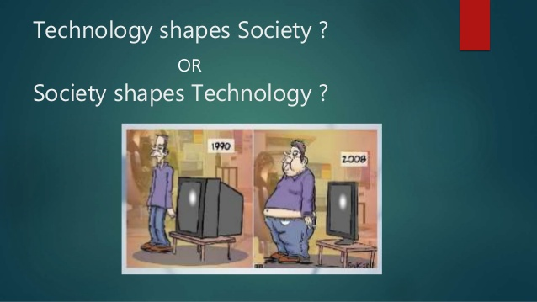
Society and Technology
“We Shape Our Tools, and Thereafter Our Tools Shape Us”
- Marshall McLuhan

Slide 5
Society and Technology
To ask questions: “How do society and technology interact” is asking the Life, the Universe and Everything.
Does technology shapes society or vice-versa?
What is the role of social in technological change?
Do social innovation and technology innovation proceed co-terminously?
It is widely accepted that the relationship between technology and society is not all one way.

Slide 6
Society and Technology
There are two schools of thought on the topic of the benefit of technological advancements.
When asking, “how does technology affect our society,” there is not cut-and-dry answer and largely the argument is subjective.
Some will applaud the positive effects of social media saying that it brings extended families closer together and allows us to connect with loved ones across a great distance.
Others will point out some of the more negative effects of technology and say that social media cheapens relationships and has brought a sense of narcissism to society.

Slide 7
Society and Technology
Similarly, some will point out that medical advancements brought about by technological research are obviously welcomed by society at large.
Others will counteract that statement and say that modern medicine has created capitalist monsters like big-pharma and even created new medical problems.
It’s hard, if not impossible, to reach a fact-based consensus on the level of impact technological advancements have on our current society and will have on our future.
The relationship between technology and society is reciprocal. Society drives technological change, while changing technologies in turn shape society.

Slide 8
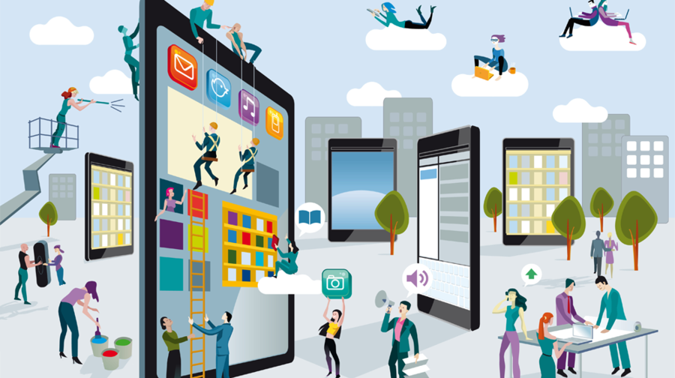
Society and Technology
Impact of technology on Society and Vice versa

Slide 9
Impact of Technology on Society and vice versa
The world is changing faster and faster as a result of accelerated technological development.
Technology has without doubt an impact on society. As a matter of fact, we experience this effect in our daily lives.
It has an effect on the growth of the economy, our culture and our living standards.
Technology and human life cannot be separated; society has a cyclical co-dependence on technology.

Slide 10
Impact of Technology on Society and vice versa
We use technology; depend on technology in our daily life.
Our needs and demands for technology is increasing daily.
We use technology to travel, to communicate, to learn, to do business and to live in comfort.
However, technology has also caused. The more advanced technology becomes, the more it seems to have control over our lives.
Technology have both positive and negative impact in our society.

Slide 11
Impact of Technology on Society and vice versa
Positive impact:
Agriculture : High production
Travel/Transportation: Mankind’s ability to travel and transport items has increased greatly.
Communication : Communicate almost at anytime or anywhere we want
Education: Advance the way our students learn.

Slide 12
Impact of Technology on Society and vice versa
Negative impact:
Agriculture : Artificially created fertilizer creates more run-off pollution for the environment
Travel/Transportation: Increases deaths/accidents and pollution
Communication : Become a society reliant on social media and communication devices
Education: Students can use technology in inappropriate ways ( adults do to sometimes)

Slide 13
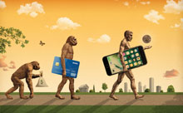
Impact of Technology on Society and vice versa
How society influence technology?
“Necessity is the mother of invention.”

Slide 14
Impact of Technology on Society and vice versa
How society influence technology?
Society needs a device. Technology are applied to invent it. Technology are used to improve it.
Technology are applied in finding a substitute. Why? To satisfy an insatiable society .
Therefore society has influenced the development of technology by its demands.
This is not saying that the development of technology is entirely due to the demands of society.
Other factors, such as discovery, have also influenced the development of technology but it is society that has influenced its application.

Slide 15
Impact of Technology on Society and vice versa
How society influence technology?
Society and its values drive technological development.
Society always has options as to how people use technology, how that technology develops and how it ultimately impacts society.
The development of technologies is heavily dependent on demand.
The true relationship between society and technology likely exists somewhere in between social and technological determinism.
At times, society influences technological development, and that development goes on to influence society.

Slide 16
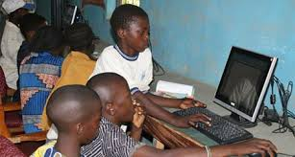
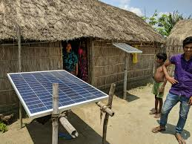
Using Technology for Poverty Alleviation

Slide 17
Using Technology for Poverty Alleviation
More than one third of population lacks resource and information to meet basics needs like food, education, shelter, health.
Throughout history technology has been a powerful instrument for economic and social development.
Technology played a critical role in reducing poverty in vast areas of the world in the past and can play today a crucial function in the battle against poverty.

Slide 18
Using Technology for Poverty Alleviation
Technology can be employed to a variety of fields,
from increasing agricultural productivity to the generation of cheap energy,
from providing clean water to improving health.
In particular, information and communications technology (ICT) can address the problem of poverty by increasing people’s access to
education,
health,
financial services
Likewise, small businesses and social enterprises creating access to primary goods are greatly helped by new technologies.

Slide 19
Health Related Issues for an IT Professional
Lower Back Pain
Carpal Tunnel Syndrome(CTS) : Wrist Pain
Anxiety and Stress
Heart Diseases
Insomnia : Difficulty in Sleeping
Neck Pain
Computer Vision Syndrome
Overweight

Slide 20

Internet and Society

Slide 21
Internet and Society
The evolution of the Internet over the past several decades and the use of the Internet into people’s daily lives makes one wonder how society operated without it for so long.
The Internet is used in all areas of people’s lives, from education to entertainment, from information to interaction.
Face-to-face, physical interaction can be replaced (not yet eliminated) via the Internet.

Slide 22
Internet and Society
The Internet is available almost everywhere in the world.
With the ongoing, rapid development of mobile applications it is anticipated that the Internet will soon be available absolutely everywhere in the world.
This is an exciting advancement for society so that all people may be united in communication.
With all major technological changes, there are positive and negative effects of the internet on the society too.

Slide 23
Internet and Society
Positive Impact:
Effective communication and Instant Messaging
Improves business interactions and transactions
Banking and Online shopping
Access free information
Online education, online library
Online jobs

Slide 24
Internet and Society
Negative Impact:
Easy availability of illegal or inappropriate materials online
Addiction to social networks
Some may use the internet to hack into people’s accounts
Misuse the internet for spreading hate and terrorism
Cybercrimes

Slide 25
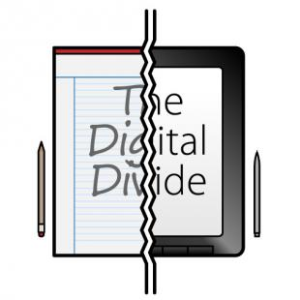

Digital Divide and Bridging the Digital Divide

Slide 26
Digital Divide and Bridging the Digital Divide
The digital divide is the gap that exists between individuals who have access to modern information and communication technology and those who lack access.
Digital inequality is evident between communities living in urban areas and those living in rural settlements;
between socioeconomic groups;
between less economically developed countries and more economically developed countries;
between the educated and uneducated population.
Individuals with access to a broadband connection can be digitally split.
How? Low-performance computers, limited broadband speeds and limited access to subscription-based content widen the gap.

Slide 27
Digital Divide and Bridging the Digital Divide
3 Types of Digital Divide
Gender Divide
Social Divide
Universal Access Divide
Causes of Digital Divide
Education
Income Levels
Geographical Restrictions
Motivation and General Interest
Digital Literacy

Slide 28
Digital Divide and Bridging the Digital Divide
How to Bridge the Digital Divide?
Increase Digital Literacy
Increase affordability
Empowering users
Improve the relevance of online content
Internet infrastructure development
Public awareness about gender gap in internet access
Provide operational incentives to information and communication technology entities
Encourage the establishment of cyber clubs

Slide 29

Governance of Internet
Internet governance is the development and application by Governments, the private sector and civil society, in their respective roles, of shared principles, norms, rules, decision-making procedures, and programs that shape the evolution and use of the Internet.
World Summit on the Information Society (WSIS),2005

Slide 30
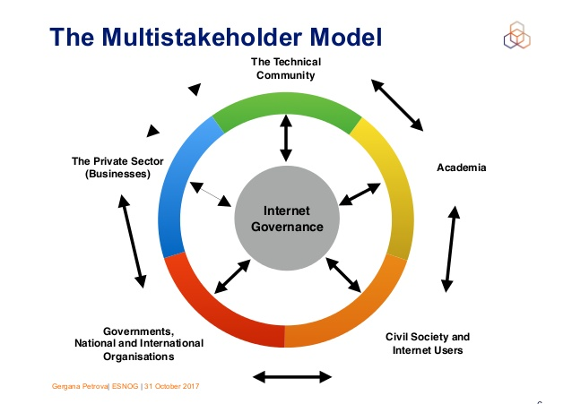
Governance of Internet

Slide 31
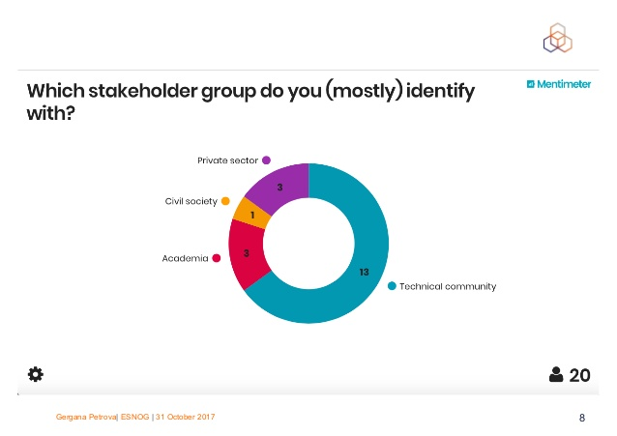
Governance of Internet

Slide 32
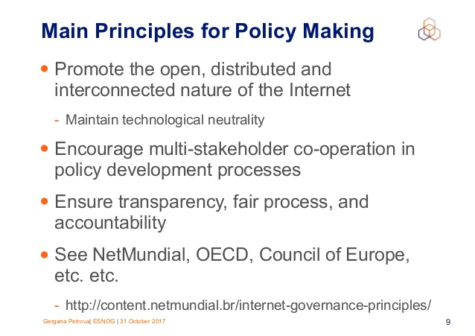
Governance of Internet

Slide 33
Governance of Internet
For more information, visit the given link below:
https://www.internetgovernance.org/what-is-internet-governance/
Internet governance refers to the rules, policies, standards and practices that coordinate and shape global cyberspace.

Slide 34
E-governance and E-government System
Assignment

Slide 35
Thank You

